Slide 1
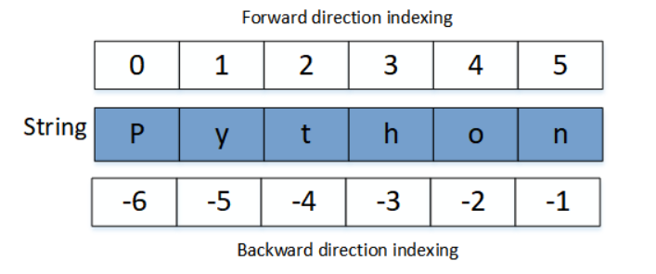
Strings In Python
String is collection of characters.
String supports indexing.

